Slide 1
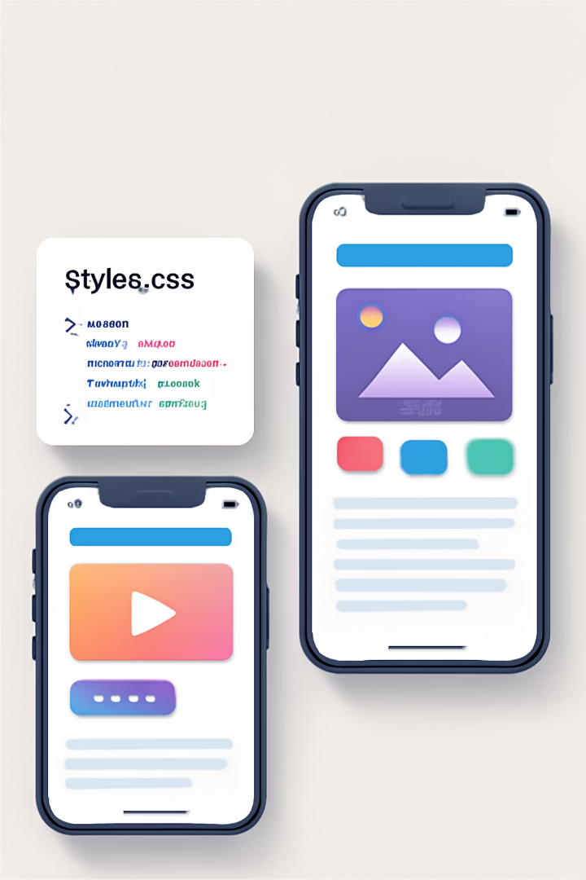
Introduction to Stylesheets in React Native
Styling in React Native happens through JavaScript, not traditional CSS. Core components accept a 'style' prop for visual customization.
React Native offers multiple styling approaches for different scenarios. All styles use camelCase naming like backgroundColor instead of background-color.

Slide 2

Why Styling Matters in React Native
Cross-Platform Consistency
Well-implemented styles ensure your app looks and feels consistent across both iOS and Android platforms.
Visual Hierarchy
Good styling creates clear visual hierarchy. Users understand what's important at a glance.
Maintainability
Structured styling approaches improve code organization. Your team can manage styles more efficiently.
Performance
The right styling techniques can significantly improve your app's rendering performance.

Slide 3





Inline Styles: The Basics
Define
Create JavaScript objects with style properties directly in components.
Apply
Pass the style object to a component's style prop.
Render
Component displays with the specified visual properties.
<Text style={{ fontSize: 24, marginBottom: 16, color: '#333', fontWeight: 'bold' }}> Inline Styles in React Native </Text>

Slide 4
Inline Styles: Pros and Cons
Pros
Cons
Quick implementation
No reusability
Component-specific
Harder to maintain
Dynamic values easily applied
No performance optimizations
No external dependencies
No static type checking
Best for: Prototyping, dynamic styles, and one-off components that don't need reusable styling.

Slide 5
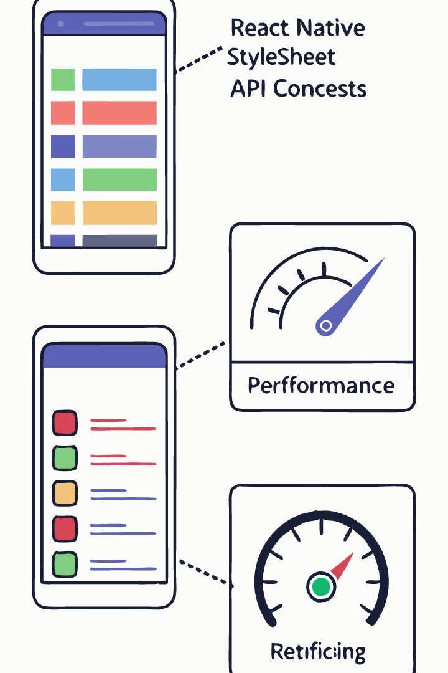
StyleSheet API: Introduction
Create StyleSheet
Define centralized style objects using StyleSheet.create()
Register Styles
React Native registers styles with unique IDs for better performance
Apply Styles
Reference registered styles by their object property names
StyleSheets are conceptually similar to CSS stylesheets but implemented in JavaScript.

Slide 6
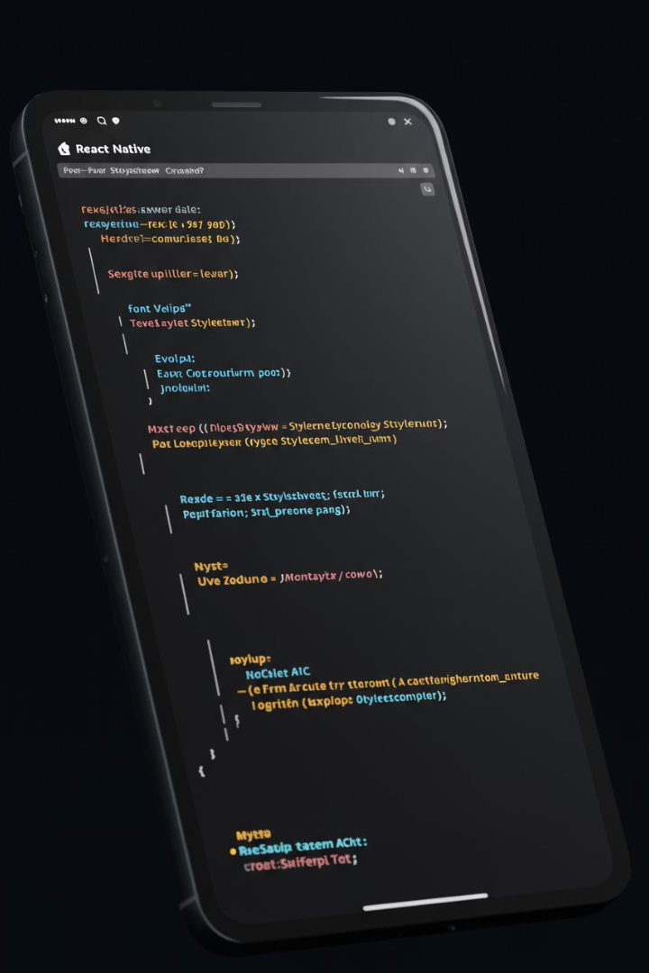



StyleSheet API: Syntax and Benefits
const styles = StyleSheet.create({
container: {
flex: 1,
backgroundColor: '#fff',
alignItems: 'center',
},
text: {
fontSize: 18,
color: '#333',
marginVertical: 10,
}
});
Performance Boost
Type Checking
ID registration optimizes style processing. Only IDs cross the bridge to native side.
Static validation against native style properties. Catch errors early.
Organization
Separate style from component logic. Improves code readability.

Slide 7





StyleSheet API: Best Practices
Outside Render
Group Related
Meaningful Names
Flat Structure
Define styles outside render function to prevent recreation on each render.
Keep related styles in a single StyleSheet for better organization.
Use descriptive names like 'container' instead of generic 'box1'.
Keep style objects flat rather than deeply nested for better performance.

Slide 8
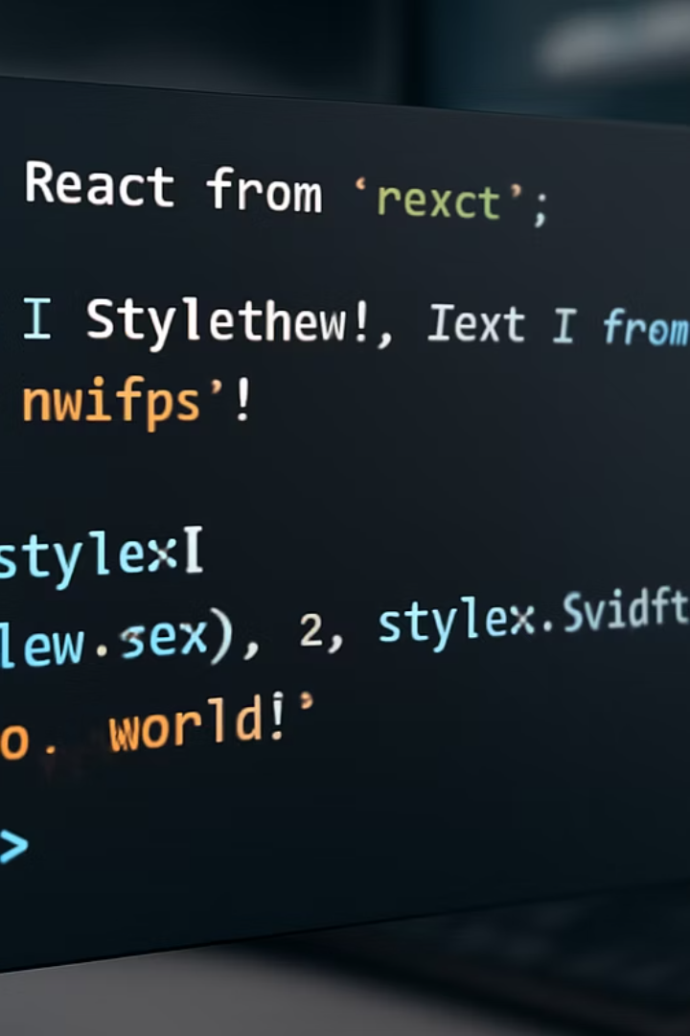
Combined Styles: Basic Techniques
Array Syntax
Pass multiple styles using arrays: style={[styles.base, styles.highlight]}
Style Precedence
Last style in array overrides previous ones. Right-most styles take priority.
Conditional Styling
Apply styles conditionally: style={[styles.base, isActive && styles.active]}
Mixed Approach
Combine StyleSheet with inline: style={[styles.base, {color: dynamicColor}]}

Slide 9








Combined Styles: Advanced Methods
StyleSheet.compose()
Merge multiple style objects efficiently
StyleSheet.flatten()
Convert array of style objects into a single object
Cascading Props
Pass styles through component hierarchy
Conditional Application
Apply styles based on state or props
These advanced techniques provide powerful flexibility for complex styling scenarios.

Slide 10
Global styles
//styles.js
import {StyleSheet} from 'react-native'
export const globalStyles = StyleSheet.create({
container:{
flex: 1,
justifyContent: 'center',
alignItems: 'center',
backgroundColor: '#f0f0f0',
},
text: {
color: 'blue',
fontSize: 20,
},
})
//App.js
import React from 'react';
import {View, Text} from 'react-native';
import {globalStyles} from './styles';
const App = ()=>{
return (
<View style={globalStyles.container}>
<Text style={globalStyles.text}>
Hello, World!
</Text>
</View>
);
};
export default App;
Global styles help maintain consistency and reusability in the application by defining common styles at a centralized location. By using global styles, you can easily apply consistent styling across different components without redundantly defining the same styles multiple times. This approach facilitates easier styling management and ensures a cohesive visual style throughout the app.

Slide 11
Themed Styles
import React from 'react';
import { View, Text, StyleSheet } from 'react-native';
import { useColorScheme } from 'react-native';
const App = () => {
const theme = useColorScheme(); // 'light' or 'dark'
return (
<View style={[styles.container, theme === 'dark' && styles.darkContainer]}>
<Text style={[styles.text, theme === 'dark' && styles.darkText]}>
Hello, World!
</Text>
</View>
);
};
export default App;
const styles = StyleSheet.create({
container: {
flex: 1,
justifyContent: 'center',
alignItems: 'center',
backgroundColor: '#FFFFFF',
},
darkContainer: {
backgroundColor: '#121212',
},
text: {
fontSize: 24,
color: '#000000',
},
darkText: {
color: '#FFFFFF',
},
});
Use themed styles when your app needs to adapt to different themes based on user preferences or system settings.

Slide 12








Platform-Specific Styles: The Problem
iOS Design Language
Android Material Design
Apple's Human Interface Guidelines specify unique styling preferences.
Google's Material Design has different visual patterns and standards.
Component Differences
Device Variations
Native components have platform-specific behaviors and appearances.
Screen sizes, densities, and capabilities differ significantly.

Slide 13

Platform-Specific Styles: Platform Module
import { Platform } from 'react-native'; const styles = StyleSheet.create({ header: { fontSize: Platform.OS === 'ios' ? 20 : 18, paddingTop: Platform.OS === 'ios' ? 40 : 10, ...Platform.select({ ios: { fontFamily: 'Helvetica' }, android: { fontFamily: 'Roboto' } }) } });
Platform.OS
Check current platform with simple conditional: Platform.OS === 'ios'
Platform.select()
Create platform-specific objects with cleaner syntax.

Slide 14



Platform-Specific Style Files
Create Platform Files
Develop separate, dedicated files for iOS and Android styling implementations to maintain clean separation of concerns
Use Naming Convention
Follow React Native's file naming pattern: ComponentName.ios.js and ComponentName.android.js for automatic platform detection
Automatic Loading
React Native intelligently imports the appropriate platform-specific file at runtime without requiring manual platform checks
This approach provides complete separation of platform-specific styling code, enhancing maintainability. It's particularly effective for components that require substantial platform-specific customization or follow distinctly different design patterns.

Slide 15
Platform-Specific Style Files: Example
Platform-Specific Style Definitions
Button.ios.js
Button.android.js
export default StyleSheet.create({ button: { borderRadius: 8, fontSize: 16, fontFamily: 'SF Pro Text', height: 44 } });
export default StyleSheet.create({
button: {
borderRadius: 4,
fontSize: 14,
fontFamily: 'Roboto',
elevation: 2,
height: 40
}
});
Implementation in Components
// Usage in Button.js
import styles from './Button.styles';
Automatic Platform Resolution
Import the correct style file automatically with a platform-neutral import statement. React Native resolves to the appropriate file based on the current platform.

Slide 16

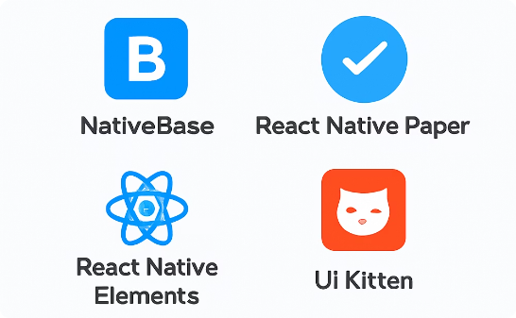
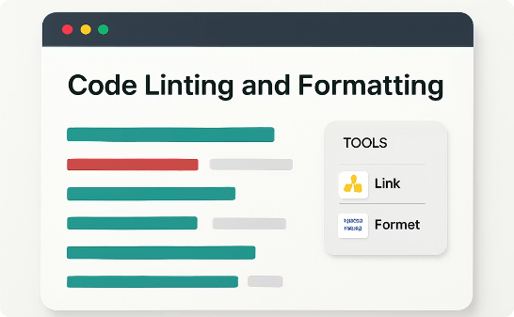
Resources and Best Practices
Official Documentation
Community Libraries
Style Linting
React Native's official style documentation provides comprehensive references and examples.
Libraries like styled-components and react-native-extended-stylesheet offer enhanced styling capabilities.
Tools like ESLint with React Native plugins help maintain consistent styling practices.
Follow a consistent naming convention. Document your style architecture. Create a style guide for your team.

Slide 17




Key Takeaways: Styling in React Native
Master these concepts to create beautifully styled and platform-optimized React Native applications.
Multiple Styling Approaches
Combined and Global Styles
Choose between inline styles for simplicity or StyleSheet API for performance and organization benefits.
Leverage style composition techniques and implement theming for consistent, maintainable styling across your application.
Platform-Specific Styling
Resources and Best Practices
Use Platform.select(), platform-specific files, and proper naming conventions to create native-feeling UIs on both iOS and Android.
Consult official documentation, consider community libraries, and implement style linting to maintain consistent styling across your team.

